Slide 1

Thesis status December
Nitai Nijholt (2nd year MSc Computational Science)

Slide 2
Overview
Thesis storyline as presentation
Motivation
RQ’s & Experiments
Results
Discussion & Limitations
Thesis written outline
Highest value focus points

Slide 3
Motivation
LLM’s as solution for expensive large variable CLD construction
CLDs are precursors to computational models that enable intervention simulations and inform new theories/experiments.
CLD construction cost scales as O(N²), making large-variable systems expensive to create - especially through group model-building sessions.
LLM-based methods can reduce CLD construction cost by providing a starting point for experts to complete
Literature on LLM-based CLD construction focusses on causal translation which can reduce hallucination through RAG, but assumes relevant corpus availability and can be capped by retrieval quality
LLM CLD generation is alternative that is relatively cheap and (external) corpus independent, but suffers from hallucinations
Corpus independent hallucination reduction methods such as multi-agent LLM-as-a-judge setup, and low-cost logit based uncertainty are corpus independent alternatives that have support for reducing hallucinations in literature, but remain untested in CLD generation context

Slide 4
Research Gap
Research Gap:
Corpus independent Multi-agent hallucination reduction methods LLM-as-a-judge, and low-cost logit based uncertainty quantification not systematically tested in CLD generation context
Contribution:
Systematically explore LLM-as-a-judge and logit based uncertainty quantification to reduce hallucinations in LLM-based CLD generation

Slide 5
Definition Hallucination
Hallucinations in LLM-based CLD edge generation
Incorrectness in causal links (erroneous absence or presence of link between variables, wrong link direction, wrong causal narrative)
Hallucination operationalization
GT lit: CLD from literature (FP/FN w.r.t lit CLD = hallucination)
GT Synth: LLM corrupted edges in LLM generated CLD (Corrupted = Hallucination)
Corruption process operationalization (HaluEval inspired, applying SD-AI CLD hallcunation types)
The Corruptor deliberately introduces controlled errors into CLDs to test whether LLM judges can detect faulty causal reasoning. It applies three corruption types with rate 0.3 to the edges with balanced distribution:
Motivation corruption – replaces valid explanations with plausible-but-flawed reasoning
Spurious edges – converts NONE relationships into false positive causal links (positive or negative relationship type)
Polarity flips – inverts POSITIVE↔NEGATIVE relationships
Key params Corruptor: model=openai:gpt4.1, temperature = 0.7, top_p=1, corruption_rate=0.3

Slide 6
Preliminaries: CLD generation
CLD generation using generator LLM
Input: variables (nodes) from GT lit,
Process: iterate pairwise over all combinations of variables pairwise (note: directed)
output:
a) relationship type positive/negative/none
b) causal narrative
Key params Generator: model=openai:gpt4.1, temperature = 0.7, top_p=1

Slide 7
Research Questions
RQ1a) LLM-as-a-judge
Can LLM-as-a-judge detect hallucinations in LLM generated CLD edges?
RQ1b) LLM-as-a-corrector
Can LLM-as-a-corrector improve hallucinations in LLM generated CLD edges?
RQ2) Generator metrics Can generator logit derived metrics detect hallucinations in LLM generated edges?
RQ3) Smart test time compute
Can generator logit metrics when used as hallucination indicators be used to deploy test-time compute to correct hallucinations in CLD edges more efficiently?

Slide 8
RQ1a) Can LLM-as-a-judge detect hallucinations in LLM generated CLD edges?

Slide 9
RQ1a: Judge description
Input: Variables, relationship type, causal narrative, prompt (baseline, CoT, Mechanistic CoT)
Judge Process (2 types):
A) Correctness Judge – verifies correctness
B) Citation Judge – verifies if articles support causal narrative (Brave search on causal narrative, up to 5 articles)
Output: Score indicating if a) the causal narrative is correct or b) the causal narrative is supported by the sources found via Brave
Correctness Judge
0: Incorrect
0.5: Partially correct
1: Correct
b) Citation Judge
0: Not supported
0.5: Partially supported
1: Fully supported

Slide 10
RQ1a: Experimental overview
Experiments
3 prompts, 3 CLD’s, 3 runs per CLD per task type (27 runs)
Task A) Correctness Judge
✅ Judge correctness vs. GT Synth
✅ Judge correctness vs. GT Lit
Task B) Citation Judge
✅ Judge citation vs. GT Lit
❌ Judge citation vs. GT Synth (not done)
Judge Performance Metrics:
AUC-ROC: Area under ROC curve (Judge score vs. hallucination status)
Correlation (r): Pearson correlation between judge score and hallucination label
Threshold-based Classification (Judge score < 0.5 = Hallucination):
F1 Score: Harmonic mean of precision TP / (TP + FP) and recall TP / (TP + FN)

Slide 11
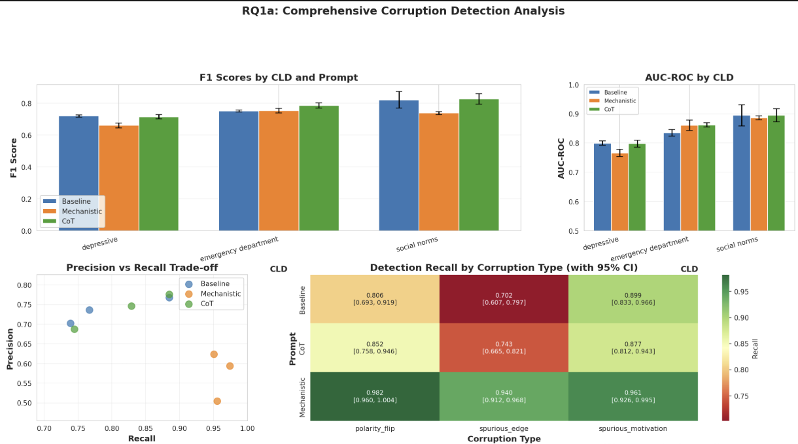
Formulation experiments results
Results RQ1a: Correctness Judge vs. Synthetic Corruption
Hallucination: Corrupted = True
Key Parameters: Judging LLM: gpt-4.1, temperature=0.0, top_p = 1
Runs = 3 per prompt & per CLD

Slide 12
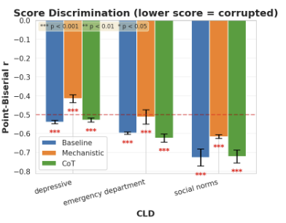
Results RQ1a: Correctness Judge vs. Synthetic Corruption
Hallucination: corrupted = True, Judge score: (0 = incorrect, 0.5 = partially_correct, 1 = correct)
Key Parameters: Judging LLM: gpt-4.1, temperature=0.0, top_p = 1, corruption rate= 0.3, corruption temperature = default
Runs = 3 per prompt & per CLD

Slide 13

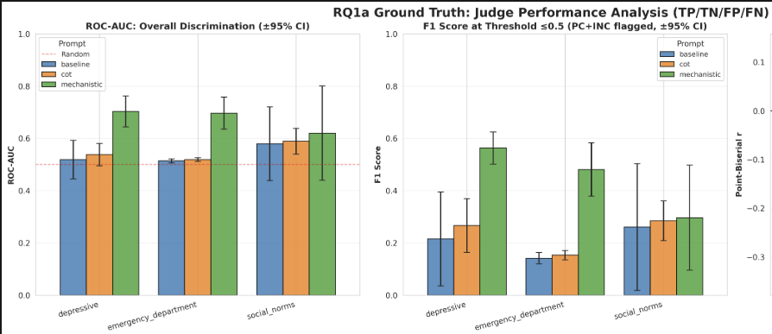
Results RQ1a: Correctness Judge vs. Lit. Ground Truth
Hallucination: FP or FN in ground truth
Key Parameters: Judging LLM: gpt-4.1, temperature=0.0, top_p = 1
Runs = 3 per prompt & per CLD

Slide 14
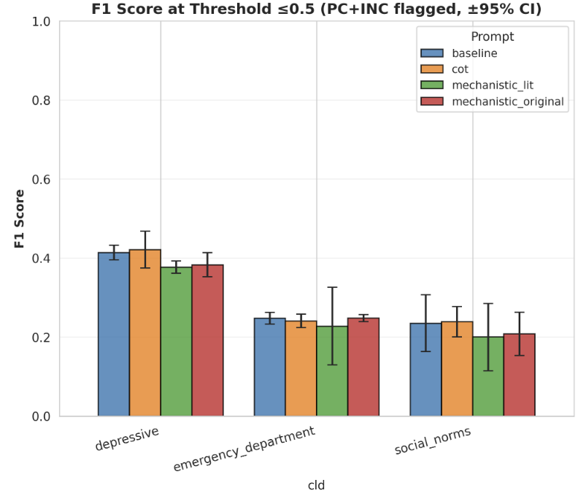
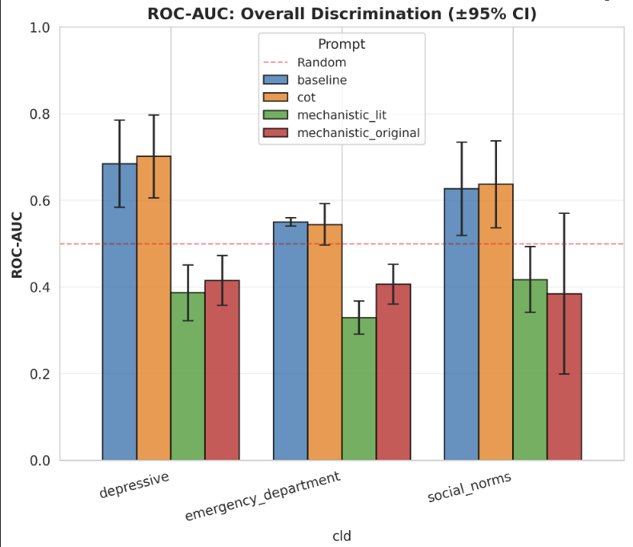
Results RQ1a: Citation Judge vs. Lit. Ground Truth
Hallucination: FP or FN in ground truth
Key Parameters: Judging LLM: gpt-4.1, temperature=0.0
Runs = 3 per prompt & per CLD

Slide 15
Results RQ1a: Citation Judge vs. Lit. Ground Truth
Hallucination: FP or FN in ground truth
Key Parameters: Judging LLM: gpt-4.1, temperature=0.0
Runs = 3 per prompt & per CLD

Slide 16
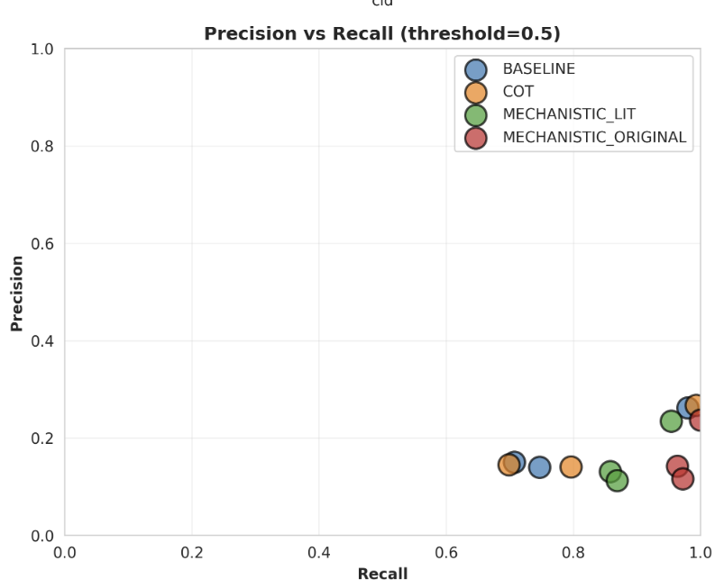
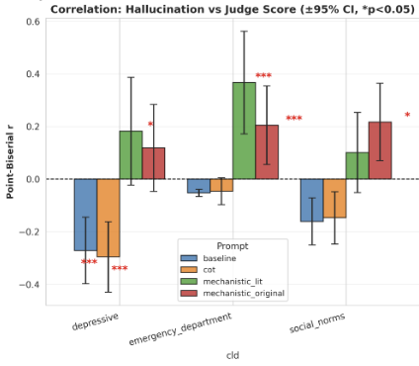
Results RQ1a: Citation Judge vs. Lit. Ground Truth
Hallucination: FP or FN in ground truth
Key Parameters: Judging LLM: gpt-4.1, temperature=0.0
Runs = 3 per prompt & per CLD

Slide 17
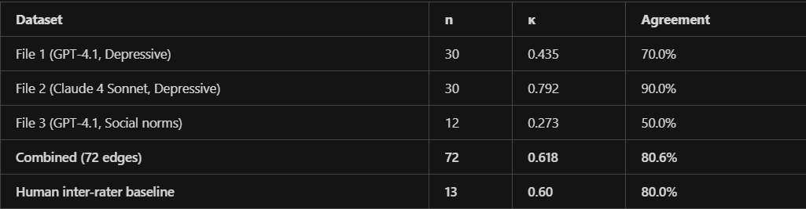
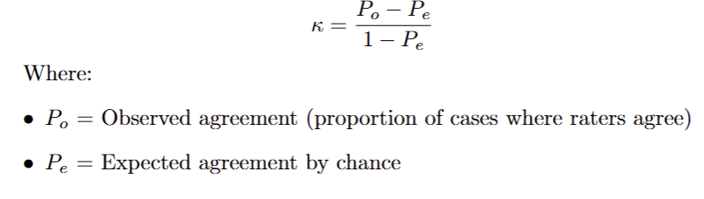
Results RQ1a: Human Validation
Hallucination: FP or FN in ground truth
Key Parameters: Judging LLM: gpt-4.1, temperature=0.0
Runs = as indicated

Slide 18
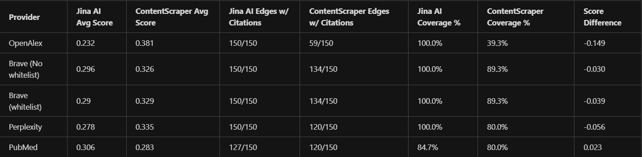
Results RQ1a: Citation Judge vs. Lit. Ground Truth
Search provider comparison (Ulemans CLD)
Hallucination: FP or FN in ground truth
Key Parameters: Judging LLM: gpt-4.1, temperature=0.0
Runs = 1, using judging baseline prompt, Ulemans CLD

Slide 19
RQ1b) Can LLM-as-a-corrector improve hallucinations in LLM generated CLD edges?

Slide 20
LLM-as-a-corrector
LLM-as-a-corrector :
Input: variables, relationship type, causal narrative, and judgement from LLM-as-a-judge
Process: changes the edge by:
a) Changing edge (relationship) type: e.g., None → Positive, Negative → None
b) Revising motivation: rewriting the causal narrative with improved reasoning/evidence
Output:
Edge with a) or b) changed

Slide 21
RQ1b: Experimental overview
Experiments
1 corrector prompts, 3 CLD’s, 3 runs, using best Judge prompt (ROC-AUC)
✅ Corrector with correctness Judge input baseline vs. GT lit
❌ Corrector with citation Judge input baseline vs. GT lit (using best Judge prompt)
❌ Corrector with citation Judge input baseline vs. GT synth
🟨 Corrector with correctness Judge input baseline vs. GT synth
Note: Corrector not employed for citation choice, as rejudging carries high cost
Evaluation metrics per experiment:
Δ F1: F1(corrected CLD) - F1(original CLD) w.r.t. GT
Δ Precision, Δ Recall: Change in precision/recall after correction
Δ Judge Score: mean(judge score corrected edges) - mean(judge score original edges)

Slide 22
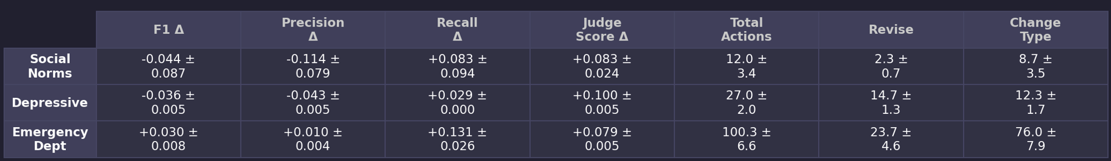
Results RQ1b: Corrector vs. GT lit (correction Judge)
Hallucination: FP or FN in ground truth
Key Parameters: Correcting LLM: gpt-4.1, temperature=0.7
Prompts: Baseline
Runs = 3 per prompt & per CLD

Slide 23
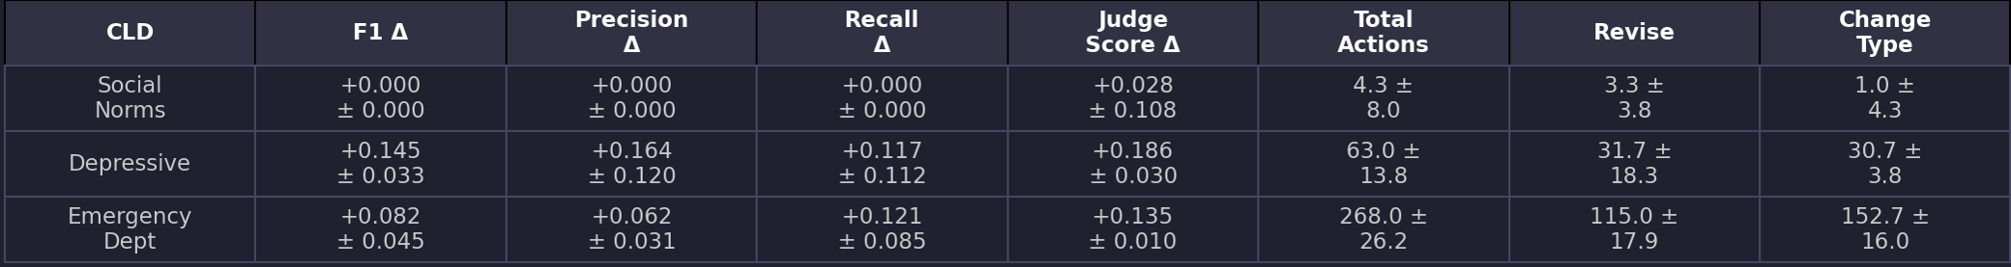
Results RQ1b: Corrector vs. GT synth (correction Judge)
Hallucination: Corrupted = True
Key Parameters: Correcting LLM: gpt-4.1, temperature=0.7
Prompts: Baseline
Runs = 3 per prompt & per CLD

Slide 24
RQ2) Can generator logit derived metrics detect hallucinations in LLM generated edges?

Slide 25
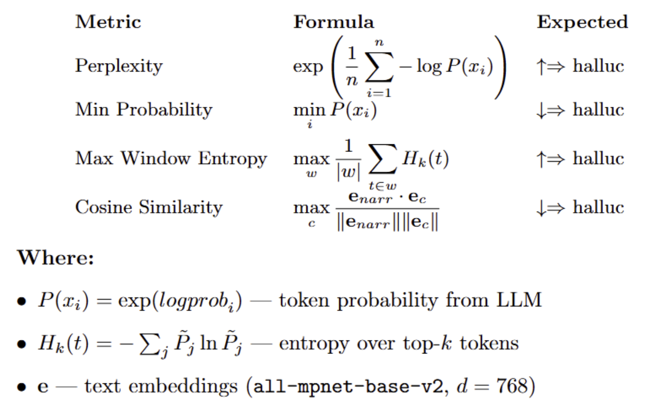
Definition Generator Logit Metrics

Slide 26
Definition Generator Logit Metrics
Gen Perplexity: Exponential of average negative log-probability of generated tokens
Gen Min Prob: Minimum token probability in generation
Gen Max Window Entropy: Maximum entropy over sliding windows of generated tokens
Gen Cosine Similarity: Max cosine similarity between generated causal narrative embedding and fetched citation chunk embeddings (citations obtained by Brave Search on Causal narrative, max 5 articles)

Slide 27
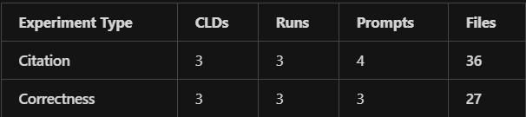
RQ2: Experimental overview
Sample:
Phase 1-3: Single Logit Metric Hallucination classification
Per file (N=63): AUC-ROC, Pearson r, t-test
Aggregate: mean AUC, mean r, T-test mean difference significant % of files
b) Phase 4: Ensemble Logit Metrics Hallucination classification
RFE Feature Selection
Nested CV (5 outer × 3 inner)
Classifiers: LogReg, Random Forest, Gradient Boosting, NeuralNet not compatible with RFE
c) Phase 5: Ensemble Comparison
4 classifiers on 80/20 split
Metrics: AUC, Precision, Recall, F1
d) Phase 6: Leave-One-CLD-Out
Train on 2 CLDs → Test on 1 CLD
Cross-domain generalization assessment
Note: cosine only on citation judge & no synthetic corruption as generator logits don’t capture inserted hallucinations through corruption

Slide 28
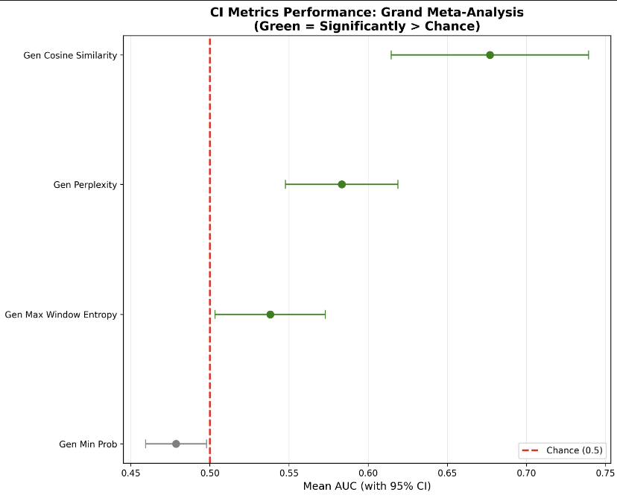
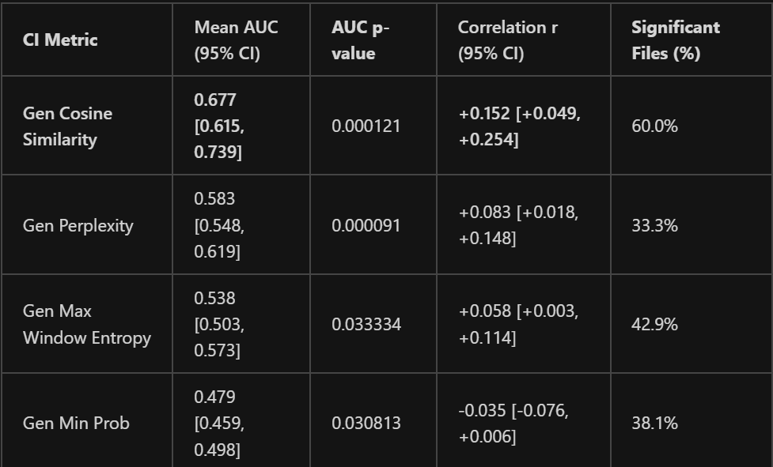
Results RQ2: Single Logit Metric Hallucination classification
Hallucination: FP or FN in ground truth
Key Parameters: Generator LLM: gpt-4.1, temperature=0.7
Runs = 63, across all 3 CLD’s
Important = NO CROSS VALIDATION YET

Slide 29
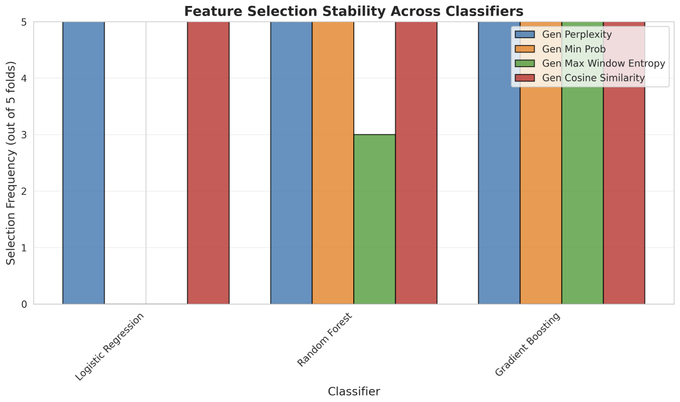
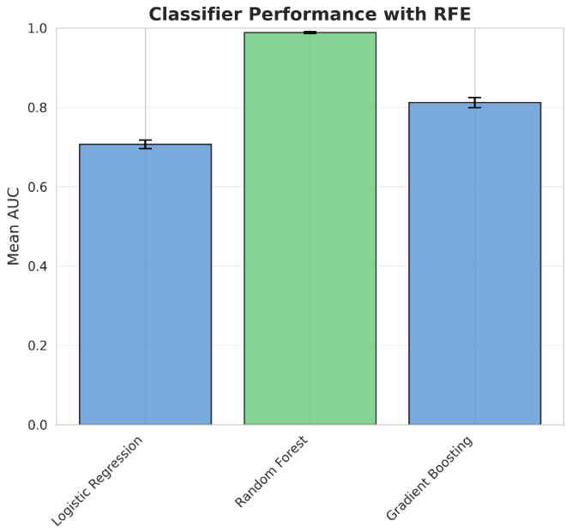
Results RQ2: RFE
Hallucination: FP or FN in ground truth
Key Parameters: Generator LLM: gpt-4.1, temperature=0.7
Runs = 63, across all 3 CLD’s
Important = No leave-one-CLD out validation yet

Slide 30
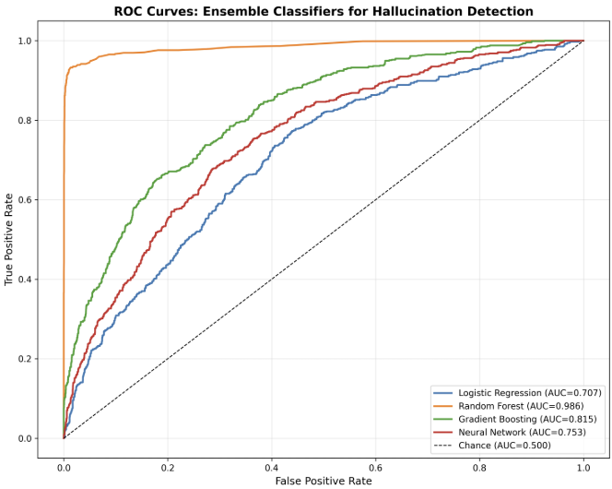
Results RQ2: Ensemble Hallucination classification
Hallucination: FP or FN in ground truth
Key Parameters: Generator LLM: gpt-4.1, temperature=0.7
Runs = 63, across all 3 CLD’s Important = No leave-one-CLD out validation yet

Slide 31
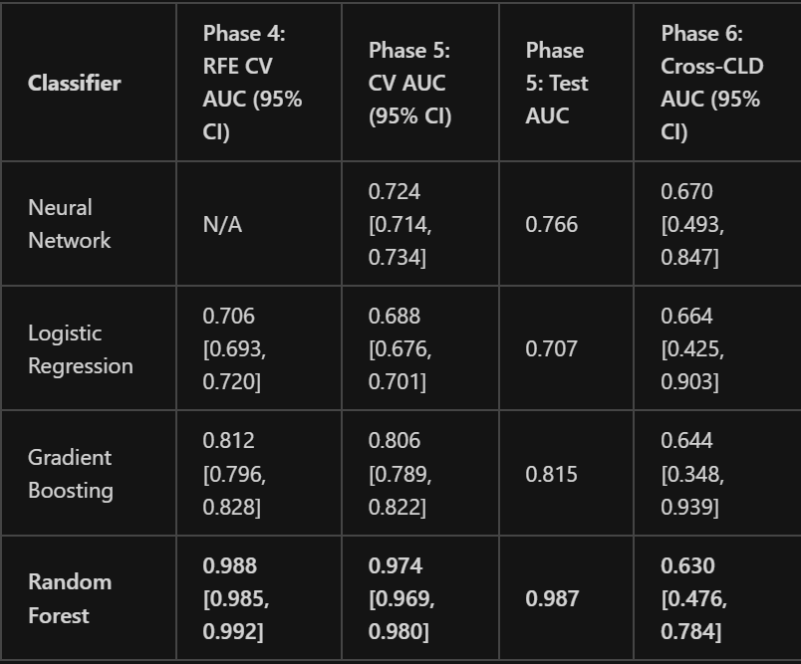
Results RQ2: Ensemble Halucination classification
Hallucination: FP or FN in ground truth
Key Parameters: Generator LLM: gpt-4.1, temperature=0.7
Runs = 56, across all 3 CLD’s

Slide 32
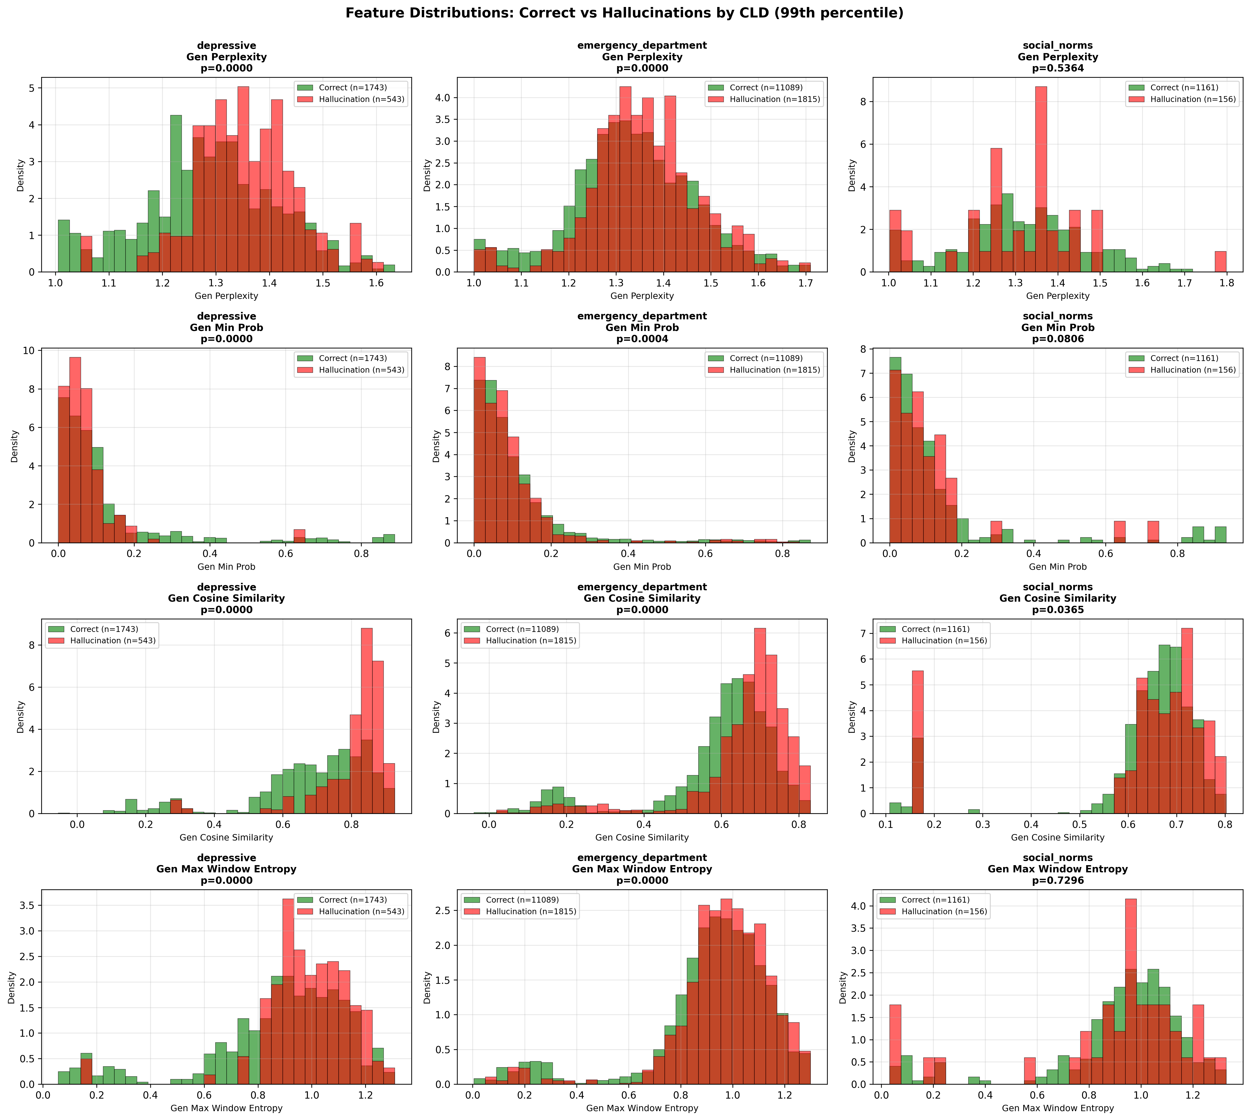
Results RQ2: Logit + Cosine Metrics
Hallucination: FP or FN in ground truth
Key Parameters: Generator LLM: gpt-4.1, temperature=0.7
Runs = 56, across all 3 CLD’s Important = NO CROSS VALIDATION YET

Slide 33
RQ3) Can generator logit metrics when used as hallucination indicators be used to deploy test-time compute to correct hallucinations in CLD edges more efficiently?

Slide 34
Experiment
RQ3) Problem: Corrector does not improve quality, deploying it “smartly” based on logit won’t increase CLD quality meaningfully.
Maybe instead we can investigate what happens if we perform a deeper search, to find causal evidence for FPs generated by the system -> If found, this would indicate GT Lit are to sparse

Slide 35
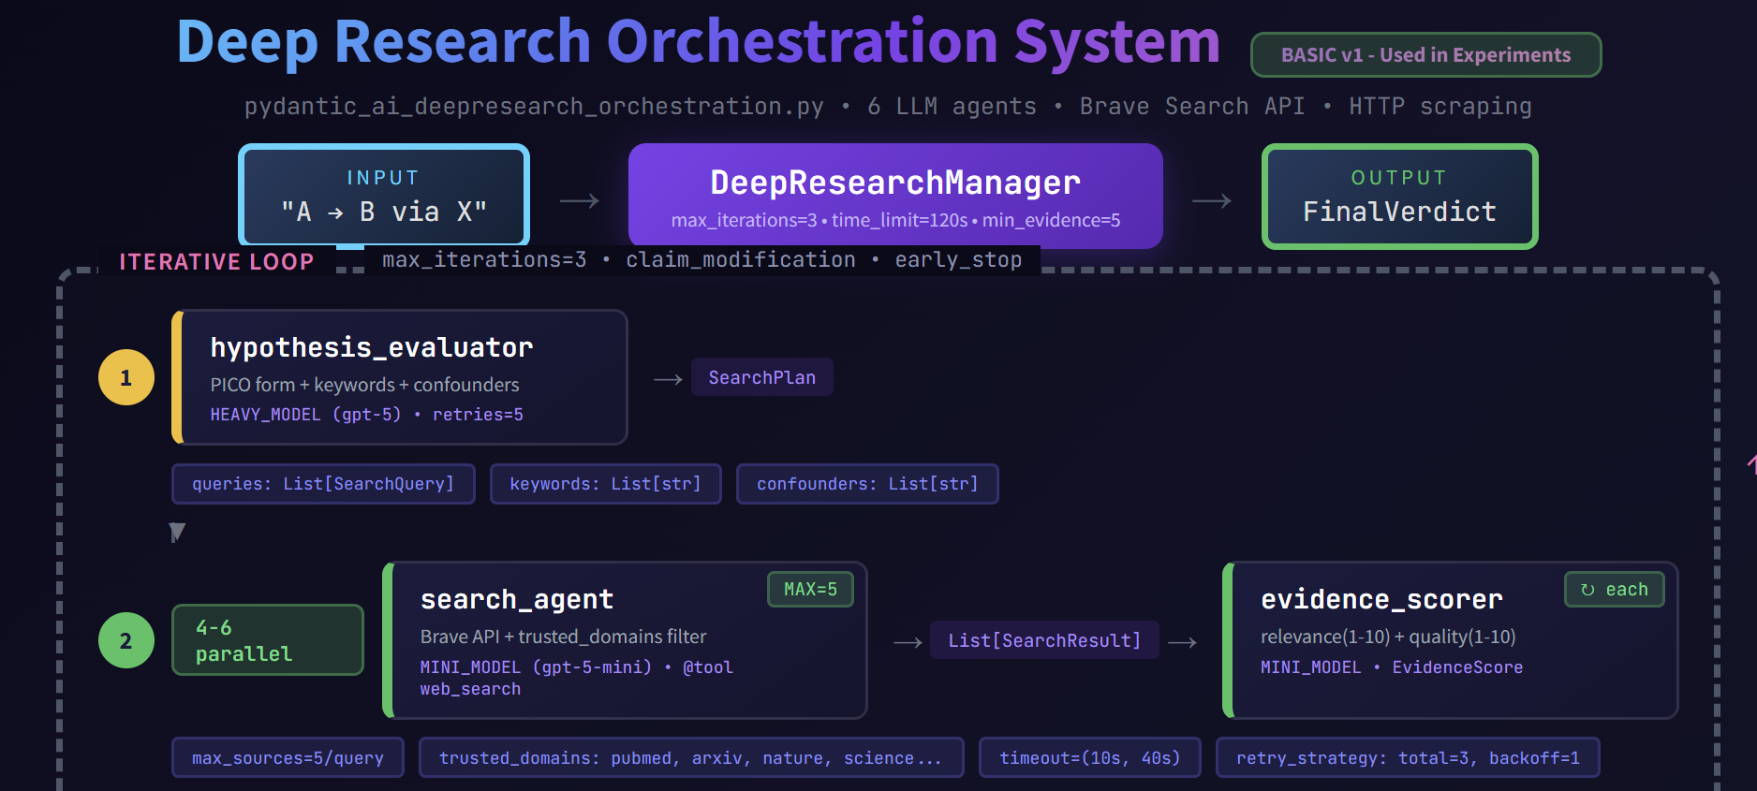
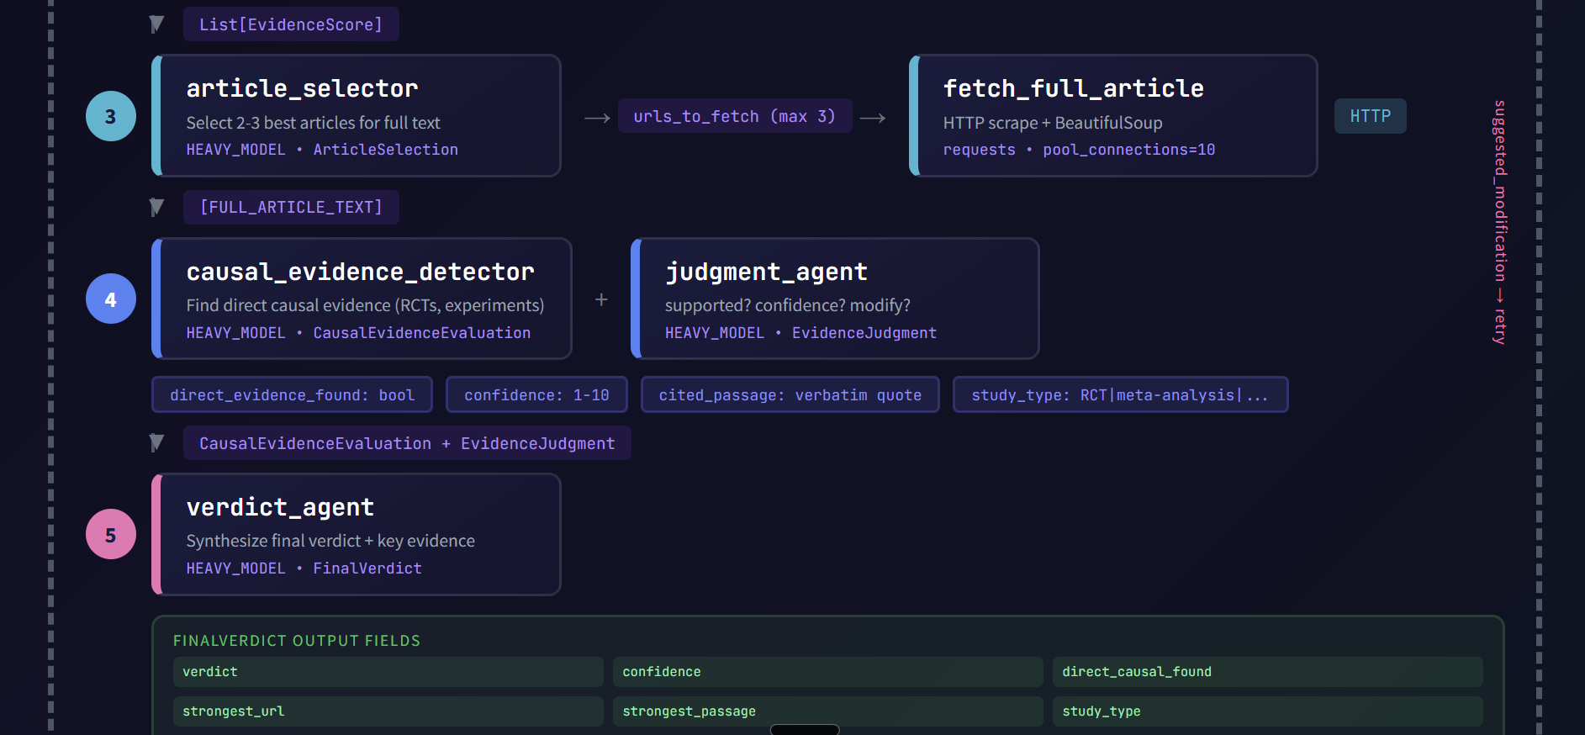
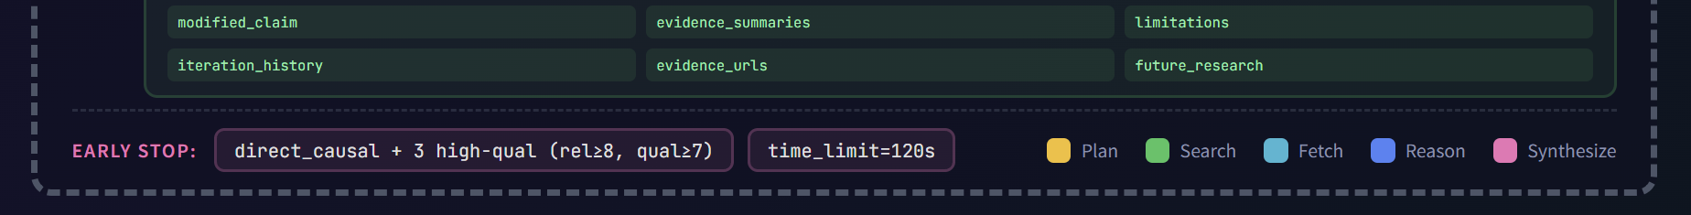
RQ 3 alternative: Deep Research system

Slide 36
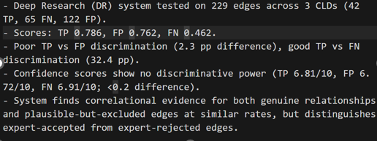
RQ3: Deep Research system Results

Slide 37
Discussion
RQ1a: Prompting matters
RQ1a: Performance of judge on synthetic hallucinations is good, but != performance on real hallucinations.
RQ1a: Citation Judge differences between True/False classes a lot smaller
RQ1a: Difference w.r.t. GT lit may not be a good hallucination measure if GT lit to sparse, more research needed (manual check on Deep Research FP’s)
RQ1a: Validation shows judge alignment with human, search provider performs adequate, and CLD with validated references also sometimes cite “less-than-causal” evidence
RQ1b: Corrector doesn’t meaningfully improve CLD quality w.r.t GT Lit using current measures
RQ2: Logit based Metrics have limiting single feature but good ensemble performance in distribution, but only weakly generalize when leaving CLD’s out
RQ3: Since corrector doesn’t work, smartly deploying it wont improve quality. Deep Research may find stronger causal evidence for FP, which could support enriching ground truths

Slide 38
Limitations
Single model
Corrupt vs. Synth GT is not same (known, but acknowledge)
Limited temp/top_p parameter exploration, argue temp less influential
Limited human validation samples
Budget limitation, corrupter + snippets
Local embedding model, limited retrieval precision
Confirmation bias in search
Logit + cosine metrics may not generalize out of distribution
CLD’s only in health domain
Limited stochasticity control (3 runs per combination), however large number of edges
Search provider judgement heterogeneity

Slide 39
Appendix & Misc results

Slide 40
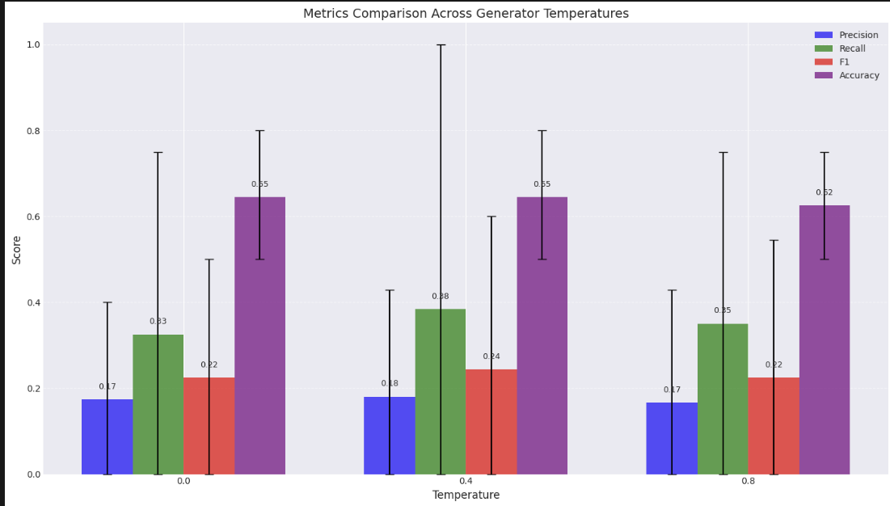
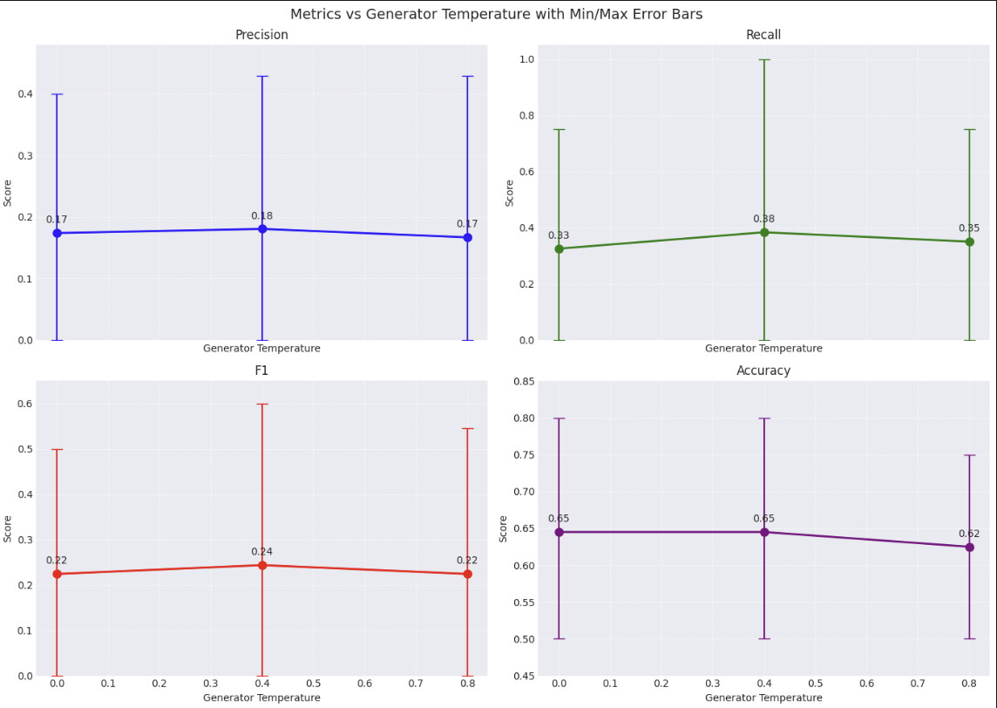
Generator Tempertaure

Slide 41
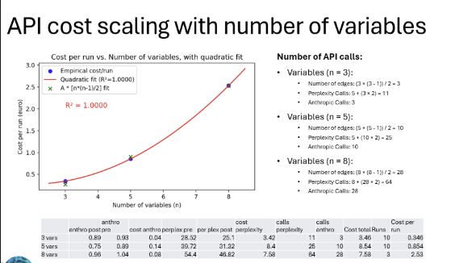

Slide 42
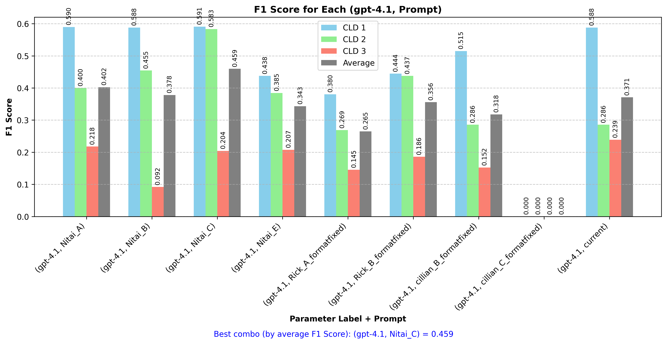
Formulation experiments results
Key Parameters: Generating LLM: OpenAI gpt-4.1, no web search, no judging, temperature=0.7
Key Parameters: Generating LLM: OpenAI gpt-4.1, no web search, no judging, temperature=0.7

Slide 43
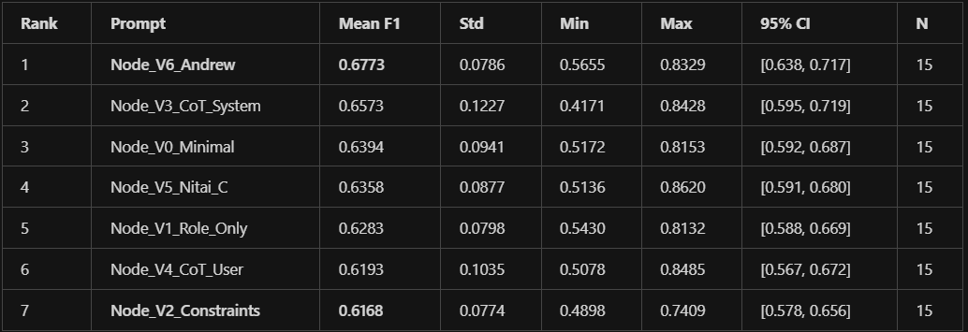
Node prompt ablation study
Experimental setup: 7 prompts × 3 CLDs × 5 runs = 105 experiments
Key Parameters: Generating LLM: OpenAI gpt-4.1, no web search, no judging, temperature=0.7

Slide 44
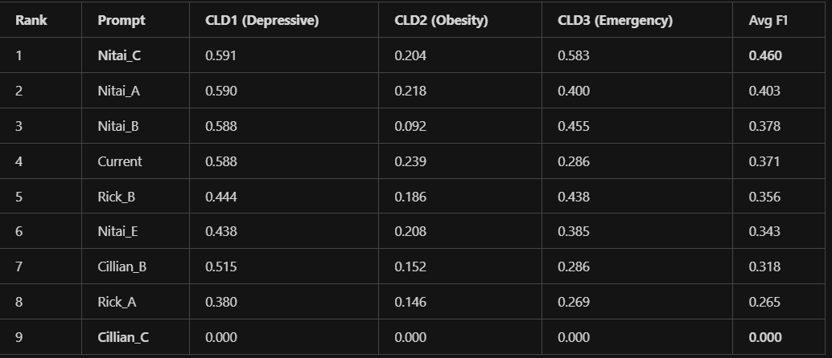
Edge ablation study
Experimental setup: 9 prompts × 3 CLDs × 1 runs = 27 experiments
Key Parameters: Generating LLM: OpenAI gpt-4.1, no web search, no judging, temperature=0.7

